Slide 1
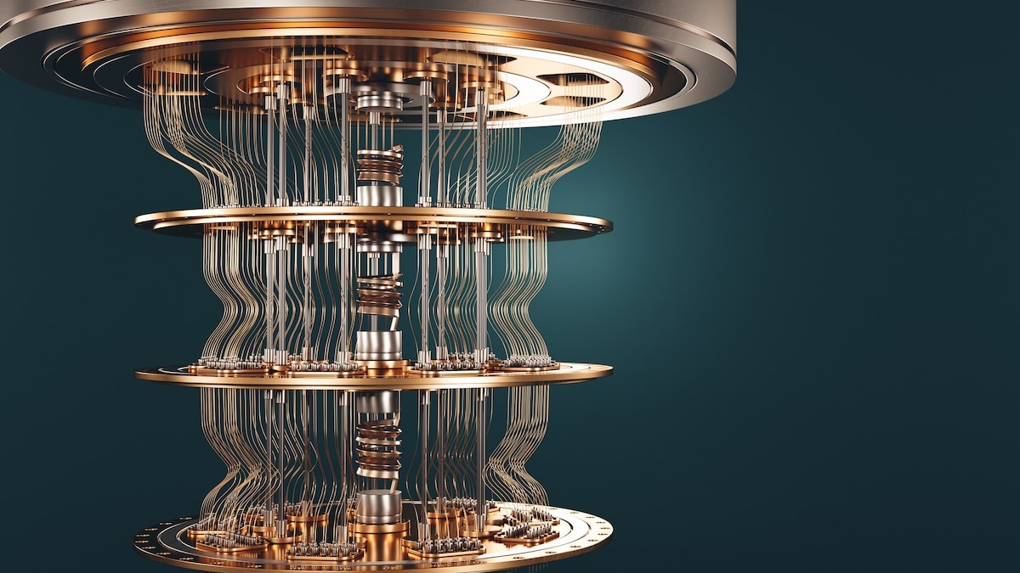
Computer Organization and Architecture
Quantum Computers
Mehmet Efe Kapısız 94074@student.pb.edu.pl

Slide 2
What is a ‘Quantum Computer’?
A quantum computer is a very special kind of computer that doesn’t work like the ones we use every day. It uses the principles of quantum mechanics to process information. Unlike classical computers, which use bits (0 or 1), quantum computers use qubits (quantum bits), which can be in multiple states at once due to superposition.
How is it different from classical computers?
Classical computers process data using bits, which are either 0 or 1, while quantum computers use qubits, which can be both 0 and 1 at the same time.
Classical computers operate based on classical physics, whereas quantum computers are based on the principles of quantum mechanics.
Classical computers handle tasks sequentially, but quantum computers can process many possibilities simultaneously thanks to superposition and entanglement.
Moreover, classical computers are limited by binary logic, while quantum computers have the potential to solve certain problems much faster.
Why is it important? Why do we need it?
Quantum computers are not just faster, they think differently. They can solve problems that classical computers can't handle efficiently. They can do many things:
Simulating molecules and atoms accurately
Keep data safe with better security
Solve really big math problems that normal computers can’t
Save time and energy on huge tasks

Slide 3
Quantum Computing: Key Concepts I
Superposition: Unlike a classical bit that is either 0 or 1, a qubit can exist in a combination of both — this is called superposition.
Entanglement: Entanglement is a phenomenon in quantum mechanics where two or more particles become linked in such a way that the state of one instantly influences the state of the other, no matter how far apart they are. This is one of the key principles that gives quantum computers their immense processing power and parallelism. For example, If two qubits are entangled, measuring one qubit as 0 will instantly cause the other to be 1 (or vice versa), even if they are separated by great distances.
Quantum Gates: Quantum gates are the quantum equivalent of classical logic gates (like AND, OR, NOT), but they operate using quantum principles such as superposition and entanglement, enabling much more complex operations. Quantum gates are used to manipulate the state of qubits. Each gate is mathematically represented by a unitary matrix, and when applied to qubits, they transform their quantum states accordingly. Common quantum gates include; X, Y, Z Gates, H (Hadamard) Gate, CNOT Gate, Toffoli Gate, Phase Gate

Slide 4
Quantum Computing: Key Concepts II
Quantum Measurement: Quantum measurement converts a qubit's quantum state into classical information. When a qubit in superposition is measured, it collapses to either 0 or 1 with certain probabilities.
Quantum Interference: Quantum interference occurs when different quantum paths reinforce or cancel each other. It’s used in quantum algorithms to increase the probability of correct answers and suppress incorrect ones.
No-Cloning Theorem: The no-cloning theorem states that an unknown quantum state cannot be copied exactly. This is a fundamental principle of quantum mechanics and crucial for quantum cryptography.

Slide 5
Implementation of Quantum Computers II
How are quantum computers physically built?
Quantum computers consist of custom-designed quantum chips and classical control systems. The chips house qubits and operate at extremely low temperatures.
What are Qubits made of?
Qubits can be created with different physical systems. Each system has its advantages and disadvantages:
Superconducting Qubits: A superconducting current flows through metal loops. Josephson junctions are used.
Advantage: Most common method; compatible with integrated circuits.
Disadvantage: Requires extremely low temperatures (milliKelvin).
Trapped Ions: Uses charged atoms (ions) suspended in air by lasers.
Advantage: Very precise control.
Disadvantage: Slow operation times.
Photonic Qubits: Uses particles of light; controlled with optical fibers and beam splitters.
Advantage: More resistant to ambient conditions.
Disadvantage: Difficult to scale.
Key Notes:
Superconducting qubit architectures are the most commonly used.
Trapped ions operate more slowly but offer higher accuracy.
Photonic systems may be more scalable and stable in theory.

Slide 6
Implementation of Quantum Computers II
What kind of environment do quantum computers need to operate?
Quantum computers must operate in ultra-controlled environments with extreme cold that near absolute zero, high vacuum to reduce particle interactions at the atomic level, and strong magnetic shielding to maintain qubit coherence.
What are the physical architectures used by companies?
Company | Physical Architecture Type | Description
IBM | Superconducting qubits | Based on Josephson junctions. Operates in a cryostat.
Google | Superconducting qubits | Known for its Sycamore processor.
Rigetti | Superconducting qubits | Offers modular and cloud-based quantum systems.
D-Wave | Quantum annealing | Still uses superconducting qubits, but not gate-based. Different use case.
IonQ | Trapped ion qubits | Laser-controlled atoms; known for high fidelity.
Microsoft | Topological quantum computer (still in prototype stage) | Aims to use Majorana fermions. Not yet practical.

Slide 7
Programming of Quantum Computers I
How are quantum computers programmed?
Quantum computers are not devices that you can just load software on and run from scratch like classical computers. They are programmed by designing quantum circuits. Each circuit contains a series of quantum gates that perform operations on qubits. The programmer writes these circuits on the classical computer and then feeds them into a quantum processor (simulator or real hardware).
Which programming languages and tools are used?
Qiskit (IBM)
Python based
One of the most widely used libraries
Circuit drawing, simulation, visualization tools available
Cirq (Google)
Python based
Compatible with Google's quantum processors
Works with Sycamore architecture
Q# (Microsoft)
Visual Studio integration
Works with Azure Quantum platform
Braket SDK (Amazon)
Python supported
Can work with different backends (IonQ, Rigetti, etc.)

Slide 8
Programming of Quantum Computers II
What are the basic algorithms?
Some basic quantum algorithms:
Shor's Algorithm: Factors large numbers quickly.
Grover's Algorithm: Searches a database quickly.
Deutsch-Jozsa, Simon: Examples that demonstrate quantum supremacy.
How are quantum circuits designed and run?
Qubit is defined.
Quantum gates are added.
Measurement step is added.
Simulation is run on real hardware.
Results are analyzed.

Slide 9
What are quantum computing development environments and how are quantum computers programmed?
Quantum computers are programmed using quantum circuits defined in code, usually in Python. Popular environments include IBM Quantum Lab (Qiskit), Google Colab (Cirq), Microsoft Quantum Development Kit (QDK), and Amazon Braket.
How one can try or run a quantum program for free on a real quantum computer?
IBM Quantum Experience: Free experiments on IBM’s real quantum computers after registration.
Amazon Braket (paid but limited free tier): Accessible via AWS.
D-Wave Leap: Provides access with a certain amount of credits.
Microsoft Azure Quantum: Offers free quantum simulators and sometimes promotions for real quantum hardware usage.
What are some quantum computing libraries, algorithms do they offer, and their purposes?
Library | Company | Algorithms | Purposes
Qiskit | IBM | Grover, Shor, VQE, QAOA | Education, research, optimization
Cirq | Google | Quantum Fourier, teleportation | Near-hardware circuit modeling
Q# | Microsoft | Quantum walk, chemistry | Industrial scale application
PennyLane | Xanadu | VQE, QML, hybrid | Quantum machine learning
Ocean SDK | D-Wave | QUBO solver | Quantum annealing/optimization

Slide 10
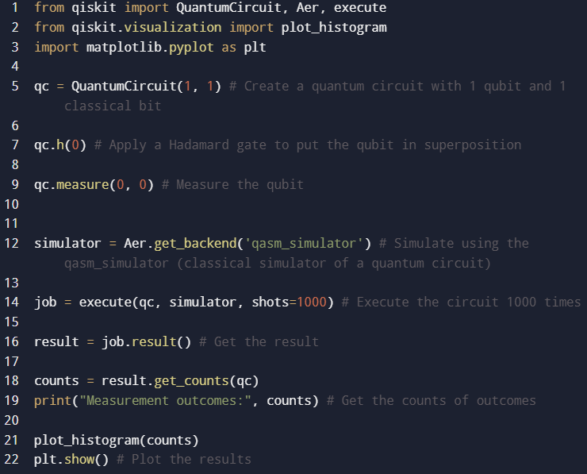
What information is available about the availability of quantum computers for purchase and their approximate pricing?
Quantum computers are not commercially available for personal purchase.
Some systems like D-Wave’s Advantage can be acquired in enterprise partnerships and may cost over $10 million.
Most users access quantum computers via cloud services.
A sample code for a simple task that can be executed on a quantum computer, along with the results of such a test program.
Expected Output
Simple Quantum Superposition Code in Python

Slide 11
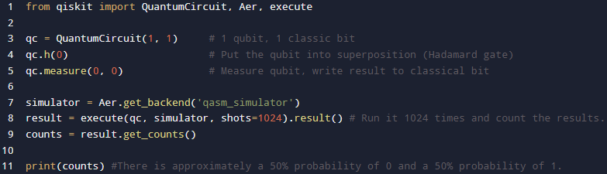
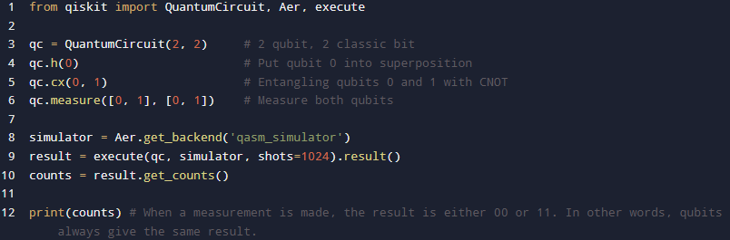
Basic Examples for Quantum Compter Coding

Slide 12
Real-World Applications
🧪 Chemistry and Materials Science
Can simulate molecules and atoms at the quantum level.
Drug discovery
Designing new materials
💼 Finance
Can perform calculations such as risk analysis and portfolio optimization much faster.
🚚 Logistics and Optimization
Shortest path problems like delivery routes and flight scheduling
🔒 Cryptography and Security
Strong enough to break some current systems
Also quantum-based security systems
🧠 Artificial Intelligence and Machine Learning
Quantum machine learning algorithms in development
Potential to learn patterns faster in large datasets

Slide 13
Limitations
High Error Rates
Qubits are very sensitive, error rates are high.
Accurate results cannot always be obtained due to “noise”.
Low Number of Qubits
Even the most powerful quantum computers have a few hundred qubits.
Not enough for large algorithms.
Requires a Stable Environment
They do not work without special conditions such as extremely low temperature, vacuum.
This makes scaling difficult.

Slide 14
Referances
Evrim Ağacı. (2024). Kuantum Bilgisayarları ve Qubit. https://evrimagaci.org/blog/kuantum-bilgisayarlari-ve-qubit-17043
İlge Bilgi Teknolojileri. (2020). Kuantum Bilgisayarlar: Geleceğin İşlem Gücü ve Güvenlik. https://ilge.com.tr/kuantum-bilgisayarlar--gelecegin-islem-gucu-ve-guvenlik
Akbulut, U. T. (2023). Quantum computing ve geleceği: Teknolojinin sınırlarını zorlayan bir devrim. Medium. https://medium.com/@umutt.akbulut/quantum-computing-ve-gelece%C4%9Fi-teknolojinin-s%C4%B1n%C4%B1rlar%C4%B1n%C4%B1-zorlayan-bir-devrim-89dd7c114fd5
Zilan, R. (2018). Kuantum teknolojiler ve uygulama alanları. Medium. https://medium.com/qturkey/kuantum-teknolojiler-ve-uygulama-alanlari-caaca0529242
Natro. (2021). Kuantum bilgisayar nedir, nasıl çalışır? https://www.natro.com/blog/kuantum-bilgisayar-nedir-nasil-calisir/​
Securitas Technology. (2020). Kuantum bilgisayarlarla gelecek nasıl değişecek? https://www.securitastechnology.com/tr-tr/blog/kuantum-bilgisayarlarla-gelecek-nasil-degisecek​
STM ThinkTech. (2018). Bir devrimin ayak sesleri: Kuantum bilgisayarlar. https://thinktech.stm.com.tr/uploads/docs/1609000709_stm-kuantum-bilgisayarlar.pdf

Slide 15
Thank you for your time.

